Slide 1



Using an attentional bias modification task through Virtual Reality to reduce fear of gaining weight and body anxiety.
Franck-Alexandre MESCHBERGER-ANNWEILER¹, Bruno PORRAS-GARCIA², Mariarca ASCIONE¹, Helena MIQUEL¹, Eduardo SERRANO-TRONCOSO³, Marta CARULLA-ROIG³, Marta FERRER-GARCIA¹ and Jose GUTIERREZ-MALDONADO¹.
Keywords. Attentional bias, Virtual reality, Body anxiety, Fear of gaining weight, Anorexia nervosa.
¹ University of Barcelona, Department of Clinical Psychology and Psychobiology;
Passeig de la Vall d’Hebron 171, 08035 Barcelona, Spain.
² University of Utah School of Medicine, Department of Population Health Science;
375 Chipeta Way, Salt Lake City, Utah, 84108. United States of America.
³ Hospital Sant Joan de Déu of Barcelona Department of Child and Adolescent Psychiatry and Psychology; Passeig de Sant Joan de Déu, 2, 08950 Esplugues de Llobregat, Spain.

Slide 2
DISCLOSURES
I, Franck Alexandre MESCHBERGER ANNWEILER, have no commercial relationships to disclose.

Slide 3


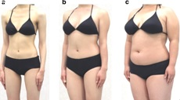
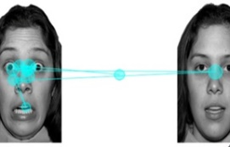
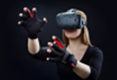
^{INTRODUCTION}
This study is to be found at the ^{crossroads of:}
CLINICAL PSYCHOLOGY (body image, eating disorders, …)
THIS
STUDY
BASIC PSYCHOLOGY
(attentional processes, concept of fixation, …)
NEW TECNOLOGIES
(virtual reality, eye-tracking, full body ownership illusion techniques, …)

Slide 4
^{INTRODUCTION}
Fear of gaining weight (FGW) is considered as one of the strongest predictors of symptomatology of Anorexia Nervosa (AN) [1], considered one of the most serious eating disorders (ED) worldwide [2].
In addition, AN patients usually experience high levels of Body Anxiety, characterized by subjective feelings of tension, worried thoughts and physical changes focused on their own body or towards specific body areas (i.e., weight-related body areas).
Body exposure therapies and especially mirror exposure therapies (MET), involving the patients systematically observing their body or specific body parts for a certain amount of time, have been proposed to reduce body-related fears and anxiety in AN patients with promising results [3].

Slide 5


^{INTRODUCTION}
However, efficacy of such therapies may decrease, due to a dysfunctional Body-Related Attentional Bias (AB), consisting in a tendency to focus more on self-reported unattractive body parts (i.e., weight-related body areas) than other body parts in ED patients and also women with high body dissatisfaction [4,5].
Previous studies shows evidences of the relationship between Body-Related Attentional Bias and Body Dissatisfaction: Women who showed higher AB towards unattractive body parts, felt greater body dissatisfaction [6,7].
AB may be reduced applying Attentional Bias Modification Tasks (ABMT), inducing the subjects to gaze at all of their body parts in a balanced way [6].

Slide 6
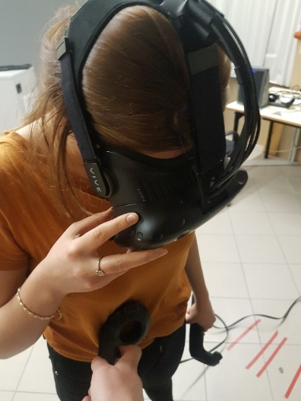
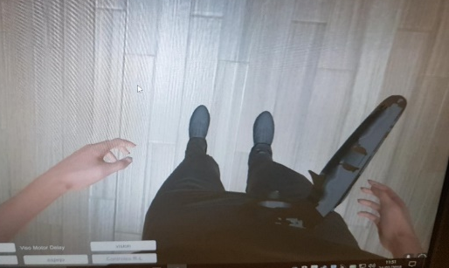
^{INTRODUCTION}
On the other side, body exposure therapies efficacy has been improved through the use of Virtual Reality (VR) as a transformative technology, including Eye-Tracking (ET) feature, enabling better treatment adherence and acceptance rate compared to in vivo exposure therapies [7,8].
VR allows researchers to create real-size 3D simulations of participants’ bodies with their physical characteristics and place them in immersive environments that reproduce real life situations related to their body image concerns (e.g., a dressing room, a beach or a bathroom, in front of a mirror), thus enhancing the generalization of positive results [9,10].

Slide 7
^{INTRODUCTION}
Our research unit at University of Barcelona has been the first to investigate how VR technology might improve research and clinical practice in AN by providing new tools to help patients confront their core fears (i.e., food- or weight-related cues) and improve their emotional, cognitive, and behavioral responses to their body image [9,10,11].
Main objective of this study
This study aims to provide initial evidences of the efficacy
of a VR-based Attentional Bias Modification Task (ABMT)
for reducing FGW and Body Anxiety.

Slide 8
^{MATERIALS AND METHODS}
Participants
73 female college students (mean age = 23.08, SD = 2.54 and mean BMI = 21.65 kg/m², SD = 2.86) participated in the study, recruited through campus flyers and advertisements in social network groups.
The exclusion criteria were a self-reported diagnosis of a current ED or current severe mental disorder diagnosis (e.g., schizophrenia or bipolar disorder).
Measures
Fear of Gaining Weight (FGW) was assessed through Visual Analog Scale from 0 to 100, answering the question: “On a scale of 0 to 100, indicate to what extent you would be afraid of gaining weight right now, being 0 "not at all" and 100 "very much“”, before and after the Attentional Bias Modification Task (ABMT)
Body Anxiety was assessed through the weight scale of the PASTAS self-reported questionnaire (8 items), before and after the Attentional Bias Modification Task (ABMT).
Body-Related Attentional Bias (AB-CFT) was assessed through VR-based procedure, using Eye-Tracking feature, described hereafter.

Slide 9
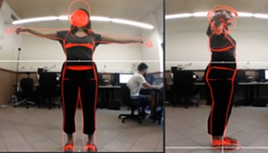
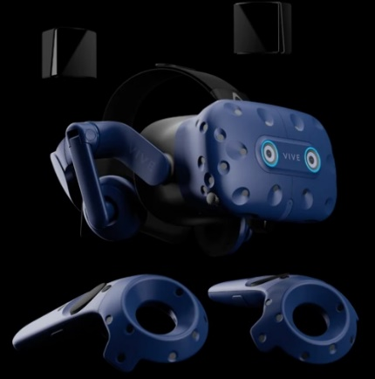
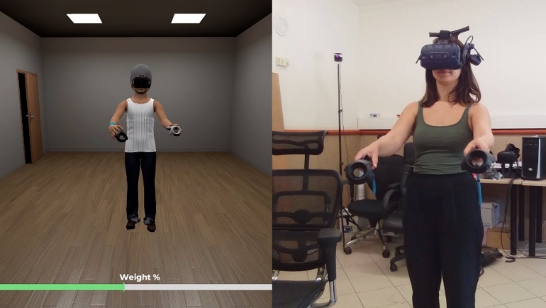
^{MATERIALS AND METHODS}
Procedure
Steps to perform Body-Related AB assessment:
We first created an avatar of each participant with the same proportions and measures, with photography procedure.
Then, all participants were immersed in a virtual environment through a head-mounted display (HMD) (HTC VIVE Pro Eye™), in which they could look in the mirror at their respective avatars.

Slide 10
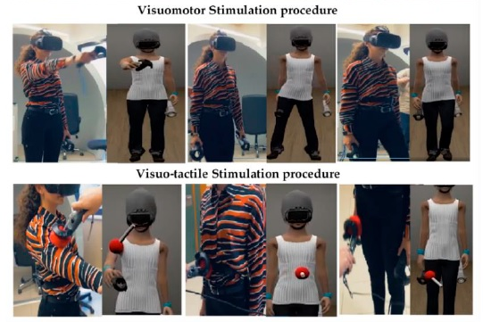
^{MATERIALS AND METHODS}
Procedure
Steps to perform Body-Related AB assessment:
Next, visuo-motor and visuo-tactile stimulations were used to induce the full body ownership illusion (FBI) (i.e., to perceive and regard a virtual body as one’s own real body).

Slide 11
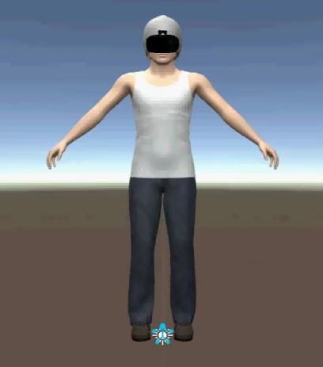
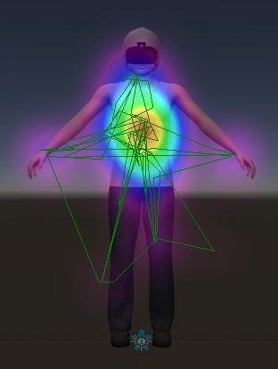
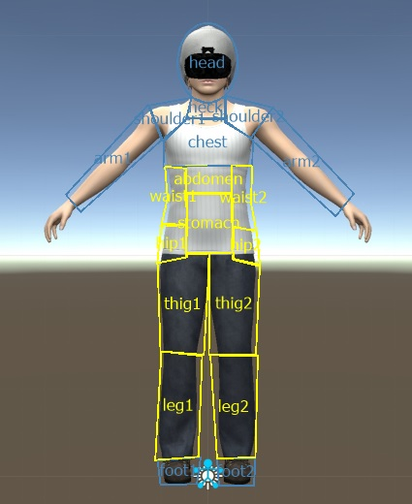
^{MATERIALS AND METHODS}
Procedure
Steps to perform Body-Related AB assessment:
The participants’ gaze was tracked while they were asked to observe their virtual body in the mirror for 30s, using the Eye-Tracking (ET) feature (Tobii™) of the HMD.
AB-CFT
=
Weight-related CFT
-
Non-Weight related CFT
AB was assessed before and after the ABMT (described hereafter), as the complete fixation time (CFT) difference between Weight- (in yellow) and Non-Weight- (in blue) related body parts (defined according to the Weight Scales items of the PASTAS questionnaire). CFT processing from ET Raw Data was realized with Ogama (Open Gaze Mouse Analyzer) software (Freie Universität, Berlin, Germany).

Slide 12
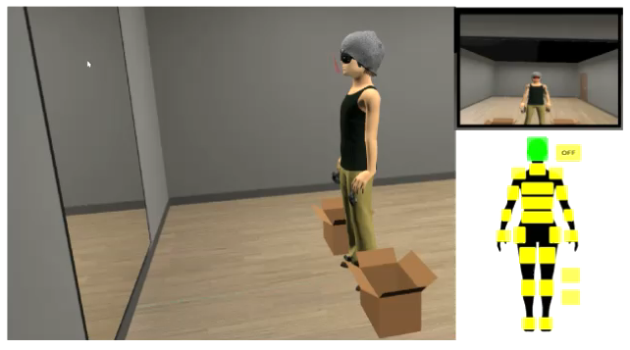
^{MATERIALS AND METHODS}
Procedure
The Attentional Bias Modification Task (ABMT):
Participants were instructed to detect and identify geometric figures that appeared in all of their avatars’ body parts, in a balanced way between weight- and non-weight- related parts (90 combinations), adapting the ABMT procedure proposed by Smeets et al. (2011) [6]

Slide 13
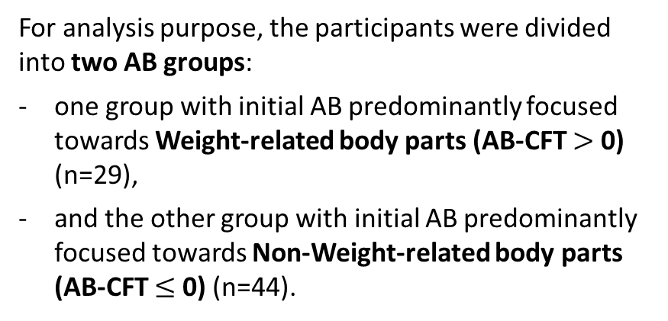
^{MATERIALS AND METHODS}
Statistical Analysis
For analysis purpose, the participants were divided into two AB groups:
one group with initial AB predominantly focused towards Weight-related body parts (AB-CFT $>$ 0) (n=29),
and the other group with initial AB predominantly focused towards Non-Weight-related body parts (AB-CFT $≤$ 0) (n=44).
Two-Way Mixed between (AB group)-within (pre-post assessment time) Analyses of Variance (ANOVA) were conducted for all measures (AB, FGW, PASTAS).
The assumptions of homogeneity of variance were met for all the variables,
as demonstrated by Levene’s test (p > 0.05).

Slide 14
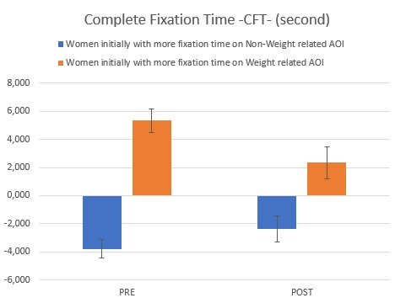
^{RESULTS}
Body-Related Attentional Bias
(Complete Fixation Time)
Two-Way Mixed between (AB group)-within (PRE-POST AB-CFT assessment time) ANOVA:
Statistically significant group*time interactions: F(1, 69) = 6.442,
p = 0.013, partial η² = 0.085
Post hoc analysis:
Marginal significant reduction in AB, after the intervention, only in the group with initial AB predominantly towards weight-related body parts:
p = 0.056, 95% CI [-76.232; 6074.232]
Error bars represent standard errors
of the mean

Slide 15
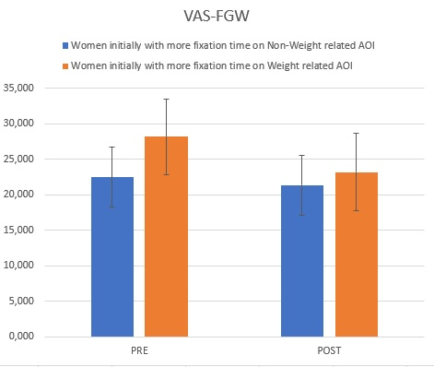
^{RESULTS}
Fear of Gaining Weight (VAS-FGW)
Two-Way Mixed between (AB group)-within (PRE-POST VAS-FGW assessment time) ANOVA:
Marginal statistically significant group*time interactions:
F(1, 69) = 3.531, p = 0.064,
partial η² = 0.049
Paired Samples t-Test (PRE-POST intervention for each AB group):
Marginal significant reduction in FGW, after the intervention, only in the group with initial AB predominantly towards weight-related body parts:
p = 0.05, 95% CI [-0.002; 9.928]
Error bars represent standard errors
of the mean

Slide 16
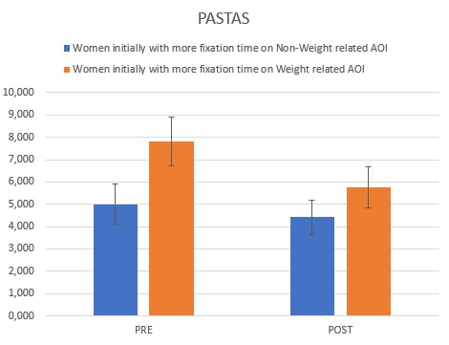
^{RESULTS}
Body Anxiety (PASTAS)
Two-Way Mixed between (AB group)-within (PRE-POST PASTAS assessment time) ANOVA:
No statistically significant group*time interactions: F(1, 70) = 2.960, p = 0.09, partial η² = 0.041
Paired Samples t-Test (PRE-POST intervention for each AB group):
Significant reduction in Body Anxiety, after the intervention, only in the group with initial AB predominantly towards weight-related body parts:
p = 0.007, 95% CI [0.603; 3.535]
Error bars represent standard errors
of the mean

Slide 17
^{CONCLUSION}
This study shows promising results regarding the opportunity of using VR and ET technologies to reduce the attentional bias, the fear of gaining weight and the body anxiety, considered as important risks and maintenance factors for developing or maintaining AN symptomatology.
Hence, the use of VR may contribute to increase the efficacy of body exposure therapies and to propose adjunctive therapies improving usual AN treatment.

Slide 18

^{THANK YOU FOR YOUR ATTENTION}
^{More information @}
^{franck.meschberger@ub.edu}
^{jgutierrezm@ub.edu}
Do not hesitate to post questions or comments
on the ICED 2022 online platform !

Slide 19
^{ACKNOWLEGMENTS}
This study was funded by the Spanish Ministry of Science and Innovation (Ministerio de Ciencia e Innovación, Spain. Project PID2019-108657RB-I00: Modification of attentional bias, with virtual reality, for improving anorexia nervosa treatment) and by AGAUR, Generalitat de Catalunya, 2017SGR1693.

Slide 20
^{REFERENCES}
[1] Linardon, J.; Phillipou, A.; Castle, D.; Newton, R.; Harrison, P.; Cistullo, L.L.; Griffiths, S.; Hindle, A.; Brennan, L. (2018). The relative associations of shape and weight over-evaluation, preoccupation, dissatisfaction, and fear of weight gain with measures of psychopathology: An extension study in individuals with anorexia nervosa. Eat. Behav. 2018, 29, 54–58.
[2] Hoek, H.W. (2016). Review of the worldwide epidemiology of eating disorders. Curr. Opin. Psychiatry 2016, 29, 336–339.
[3] S. S. Delinsky and G. T. Wilson. (2006). Mirror exposure for the treatment of body image disturbance, International Journal of Eating Disorders 2006, 39.
[4] A. Jansen, C. Nederkoorn, S. Mulkens. (2005). Selective visual attention for ugly and beautiful body parts in eating disorders, Behaviour research and therapy 2005, 43, 183-196.
[5] A. Bauer, S. Schneider, M. Waldorf, K. Braks, T. J. Huber, D. Adolph, S. Vocks. (2017). Selective visual attention towards oneself and associated state body satisfaction: an eye-tracking study in adolescents with different types of eating disorders, Journal of Abnormal Child Psychology 2017, 45, 1-15.
[6] Smeets, E.; Jansen, A.; Roefs, A. (2011). Bias for the (un)attractive self: On the role of attention in causing body (dis)satisfaction. Heal. Psychol. 2011, 30, 360–367.

Slide 21
^{REFERENCES}
[7] Kerr‐Gaffney, J., Harrison, A., & Tchanturia, K. (2019). Eye‐tracking research in eating disorders: A systematic review. International Journal of Eating Disorders, 52(1), 3-27.
[8] García-Palacios, A.; Botella, C.; Hoffman, H. & Fabregat, S. (2007). Comparing Acceptance and Refusal Rates of Virtual Reality Exposure vs. In Vivo Exposure by Patients with Specific Phobias. Cyberpsychol. Behav. 2007, 10, 722–724.
[9] Gutiérrez-Maldonado, J.; Wiederhold, B.K.; Riva, G. (2016). Future directions: How virtual reality can further improve the assessment and treatment of eating disorders and obesity. Cyberpsychol. Behav. Soc. Netw. 2016, 19, 148–153.
[10] Gutiérrez-Maldonado, J.; Ferrer-García, M.; Dakanalis, A.; Riva, G. (2018). Virtual reality: Applications to eating disorders. In The Oxford Handbook of Eating Disorders; Oxford University Press: Oxford, UK, 2018.
[11] Porras-Garcia, B.; Serrano-Troncoso, E.; Carulla-Roig, M.; Soto-Usera, P.; Ferrer-Garcia, M.; Figueras-Puigderrajols, N.; Yilmaz, L.; Onur Sen, Y.; Shojaeian, N.; Gutiérrez-Maldonado, J. (2020). Virtual Reality Body Exposure Therapy for Anorexia Nervosa. A Case Report with Follow-Up Results. Front. Psychol. 2020, 11, 956.

Slide 22
^{THANK YOU FOR YOUR ATTENTION}
^{More information @}
^{franck.meschberger@ub.edu}
^{jgutierrezm@ub.edu}
Do not hesitate to post questions or comments
on the ICED 2022 online platform !

